Slide 1
Rocket Simulator
Presented in concept of programming languages course at BAU

Slide 2
Our Team
ASEEL FATAYERJI
AHMAD ALHAICH
MAHMOUD SHAWISH

Slide 3

Overview:
Introduction
Our project is inspired by the NASA Falcon 9 rocket that landed on a ship in the sea in 2018, So we develop a simulator that launch a rocket then land it on a boat, designed using python language and this can be done by the user or using artificial intelligence that uses algorithms to control the rocket to land smoothly.

Slide 4
Semantics: (Variables)
In Python the variables are pointers, and to define a variable all you require is a variable name , the value and an equal sign in between you.
In Java in order to declare a variable it has to be given a type, but it’s value can be declared later on.

Slide 5
Semantics: (Objects)
Python is an object-oriented programming language, and in Python everything is an object, which means every entity has some metadata (called attributes) and associated functionality (called methods). These attributes and methods are accessed via the dot syntax
Java is also an object-oriented programming language ,but not everything in is an object like in Python instead objects can be created using a separate class and assiging it it’s own attributes and methods.

Slide 6
Tradeoff between Java an python:
Python | Java
def | Static
global | Type
: | { }
In range | (int var = from ; to ; counter)
Elif | Else if
And | &&
Or | ||

Slide 7
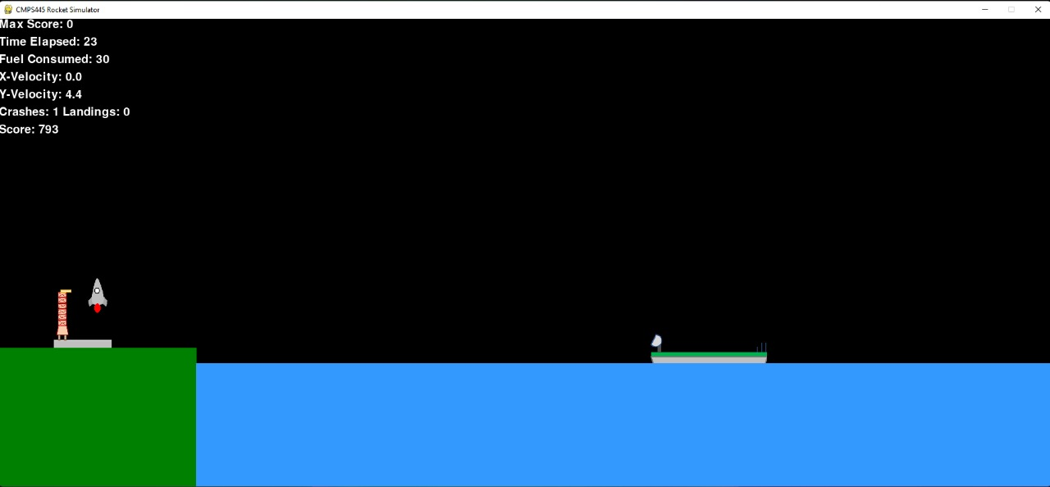
Phases:
when simulation starts, the rocket will begin the boosting phase which will initiate the main thruster to lift the rocket upward.

Slide 8
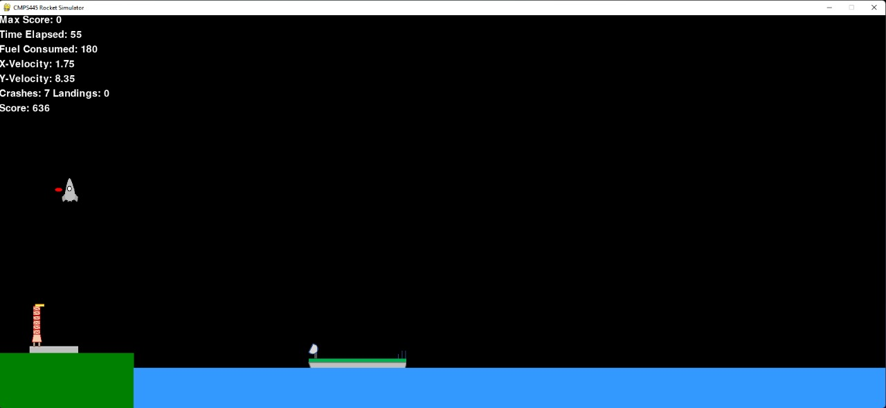
Phases:
2. when the rocket reach half way across the height of the screen the main thruster will shut down and the left thruster will be initiated.

Slide 9
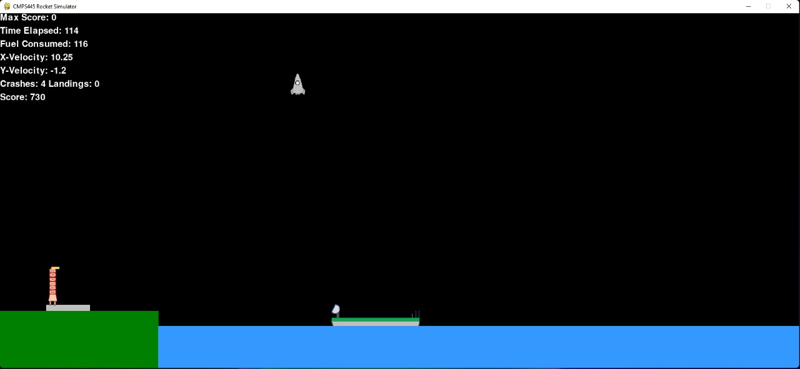
Phases:
3.when the rocket reach a point to be above the sea, the control will be transmitted to the main navigator (user), which will start initiating the left, right and main thrusters to navigate the rocket.

Slide 10
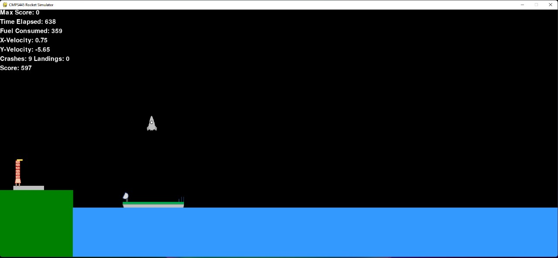
Phases:
4. finally if the user navigate the rocket successfully in order to reach the landing boat, the landing mission will be success , else it would be fail.

Slide 11
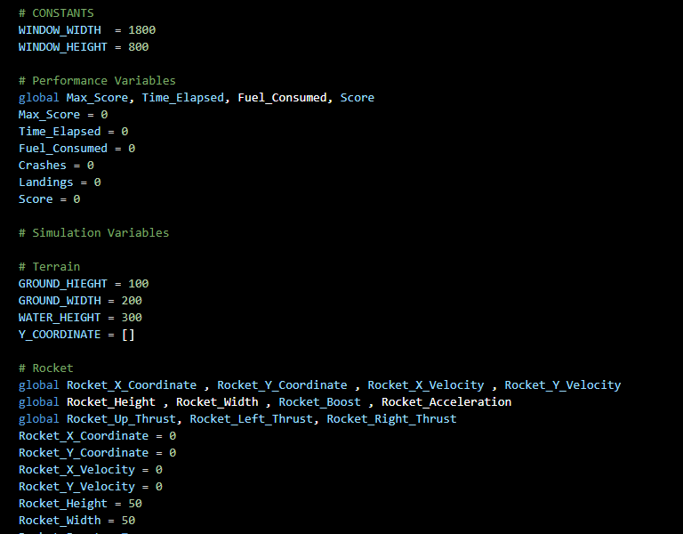
How the program was built?
first step: we initialize variables for the ground height and width , and water level in addition for rocket height, width, velocity, speed , acceleration and thrusts, for boat we initialize height ,width, and velocity.

Slide 12
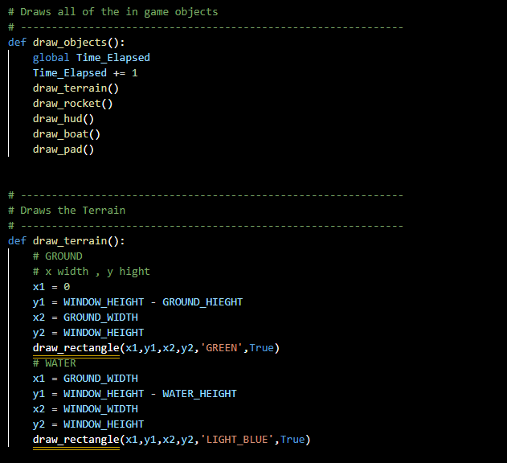
How the program was built?
Second step: we use GUI in python in order to raw the terrain, lunch Pad, Rocket, boat.

Slide 13
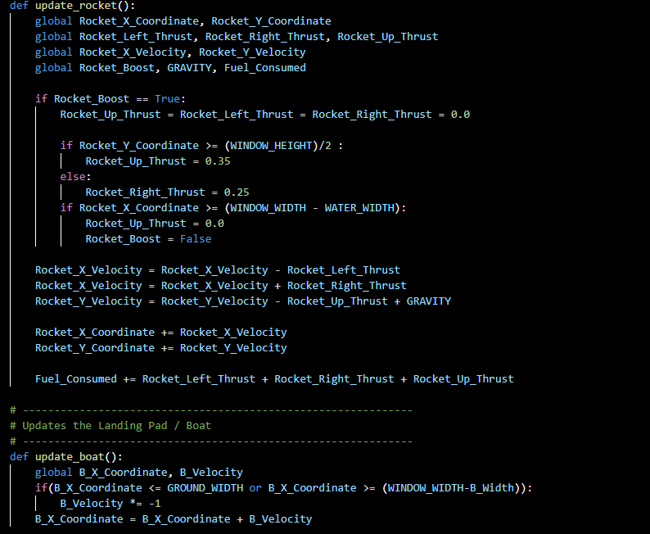
How the program was built?
Third step: We made methods to update the pad that will be moved automatically, and the rocket to harmonic with thrust that the user will made.

Slide 14
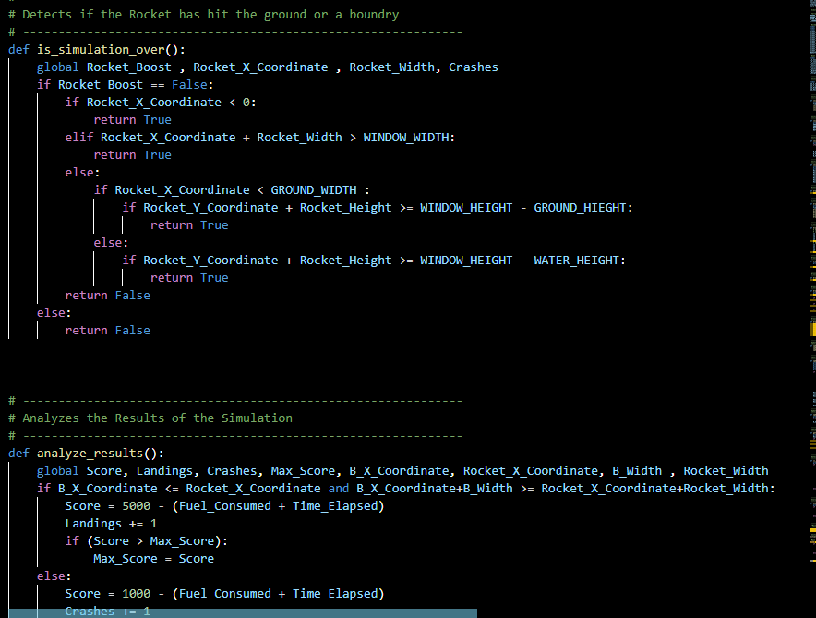
How the program was built?
Last step: we made two methods the first contain equations to compute the time taken, the fuel consumed, and the score the use get, the second method to detect if the rocket hit the ground or the boundary.

Slide 15
Thank you

